Slide 1
Agility Platform Services SDK

Slide 2
Agenda: Day 1
9:00 | 9:15 | Greetings
9:15 | 9:45 | Introduction to Agility Platform SDKs and Adapters | 4
9:45 | 10:15 | Lab 1: Development Environment Preparation | 13
10:15 | 10:30 | Break
10:30 | 11:00 | Software Architecture | 15
11:00 | 11:30 | Asset Types | 21
11:30 | 12:30 | Lunch
12:30 | 12:45 | Lab 2: Example Service Adapter in Agility Platform UI | 33
12:45 | 1:00 | Service Registration and Installation | 34
1:00 | 1:45 | Lab 3: Service Adapter Registration | 51
1:45 | 2:00 | Break
2:00 | 2:15 | Service Registration and Installation, cont. | 53
2:15 | 3:00 | Lab 4: Service Adapter Registration with Properties | 63
3:00 | 3:15 | Break
3:15 | 3:45 | Asynchronous Promise Framework | 65
3:45 | 4:30 | Lab 5: Promise Exercises | 81

Slide 3
Agenda: Day 2
9:00 | 9:30 | Service Provider Operations | 82
9:30 | 10:00 | Lab 6: Service Provider Operations | 89
10:00 | 10:15 | Service Instance Operations | 90
10:15 | 10:30 | Break
10:30 | 11:30 | Lab 7: Service Instance Operations | 98
11:30 | 12:30 | Lunch
12:30 | 12:45 | Instance Operations | 100
12:45 | 1:45 | Lab 8: Instance Operations | 108
1:45 | 2:00 | Break
2:00 | 2:15 | Service Instance Lifecycle Operations | 110
2:15 | 2:30 | Connection Operations | 117
2:30 | 2:45 | Asset Operations | 122
2:45 | 3:00 | Break
3:00 | 3:30 | Agility Platform Policies and Services | 129
3:30 | 3:45 | Service Adapter Packaging and Distribution | 137

Slide 4
Introduction to Agility Platform SDKs and Adapters

Slide 5
Agility Platform SDKs
An adapter mediates between the core Agility Platform™ and external capabilities
An adapter is developed via an Agility Platform Software Development Kit (SDK), which is written in Java
Pre-10.0 Agility Platform:
Cloud SDK provision and manage compute instances
SDN SDK provide Software Defined Networking
Workflow SDK customize workflow tasks
Release 10.0 Agility Platform:
Services SDK provision and manage higher level cloud services

Slide 6
Adapter Development and Delivery
An adapter is developed independently of the core Agility Platform
An adapter registers itself when its jar is deployed onto a running Agility Platform
REST operation GET adapter/ returns all registered adapters
$ curl -s -L –u<user>:<password -k -H Accept:application/json \
https://<agility_ip>:8443/agility/api/v3.2/adapter
{
"adapterInfos": [ ...
{
"dependencies": [ ...
{
"name”: "com.servicemesh.agility.sdk.cloud.spi",
"version": "3.1.0"
}, ...
],
"name": "Agility - CloudSDK OpenStack v3 Adapter",
"symbolicName": "com.servicemesh.agility.adapters.cloud.openstack",
"vendor": "Unknown",
"version": "3.0.0.0"
},
...
]
}

Slide 7
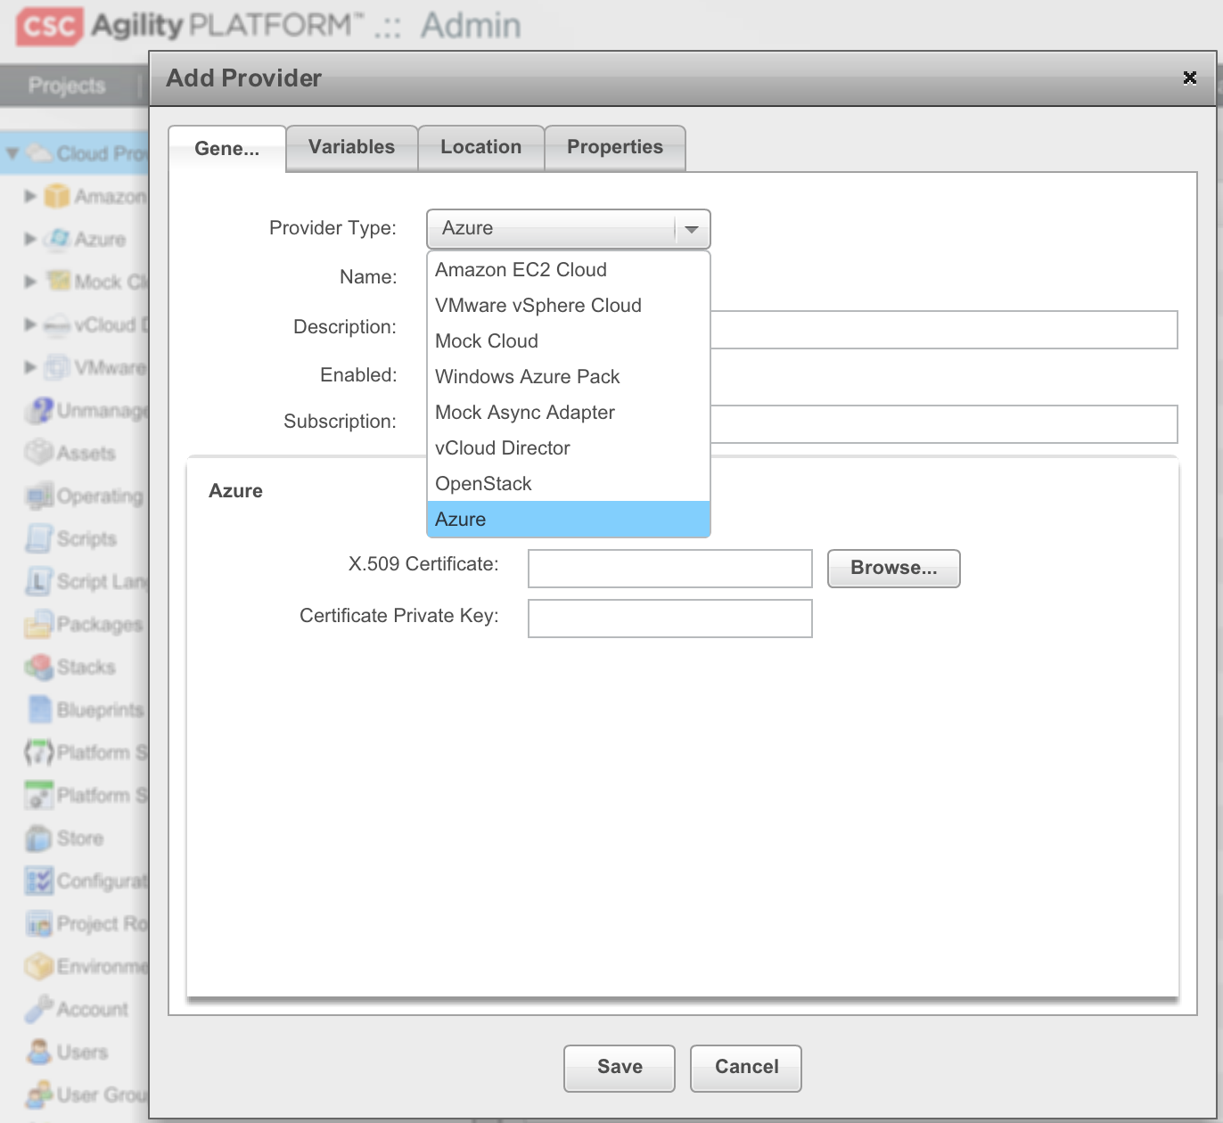
Example: Registered Cloud Adapters
Adapters built on the Cloud SDK appear as Provider Types
Azure
OpenStack
vCloud Director

Slide 8
Services SDK Frequently Used Terms
Service: can be used in the composition of applications to provide support for functionality, such as a load balancer or a database service
Analogous to a Blueprint Workload
Service Provider: defines a cloud’s end point for managing deployed services
Analogous to a cloud provider defining a cloud’s end point for managing VMs
Service Instance: represents a deployed service in a cloud
Analogous to a Topology’s Instance representing a VM in the cloud

Slide 9
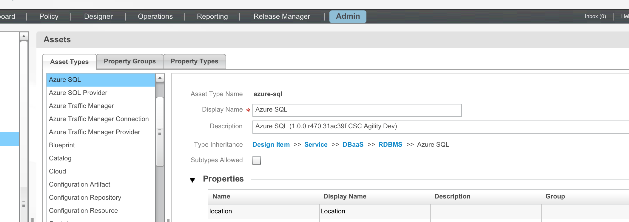
Example: Registered Service Adapters (1/3)
Adapters built on the Services SDK create Asset Types
Azure SQL
Azure Traffic Manager

Slide 10
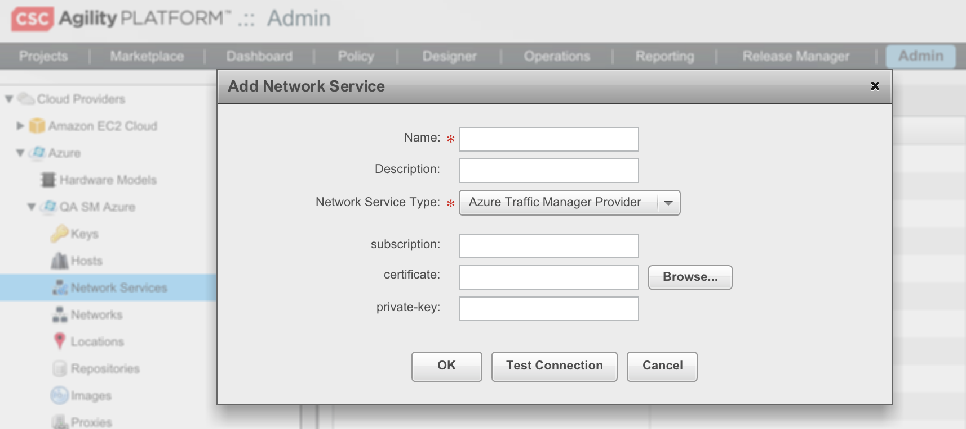
Example: Registered Service Adapters (2/3)
Service Provider Type Asset Types created by a Service Adapter appear as Network Service Types

Slide 11
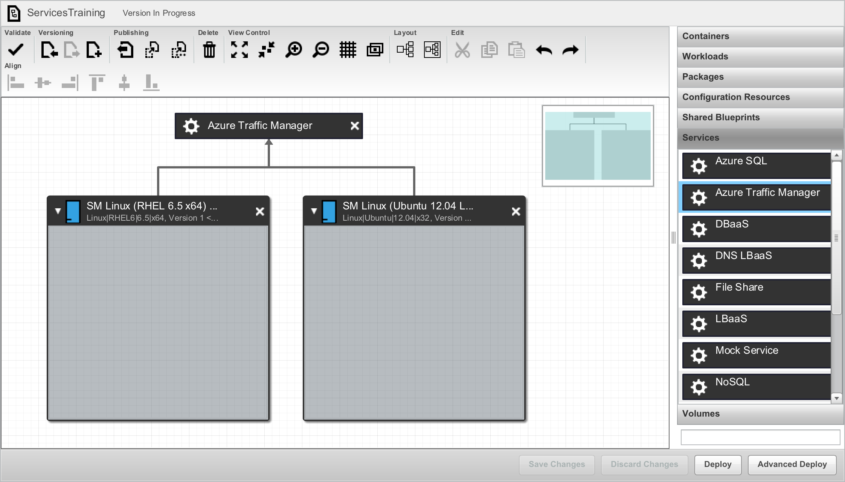
Example: Registered Service Adapters (3/3)
Service Asset Types created by a Service Adapter appear on Blueprints

Slide 12
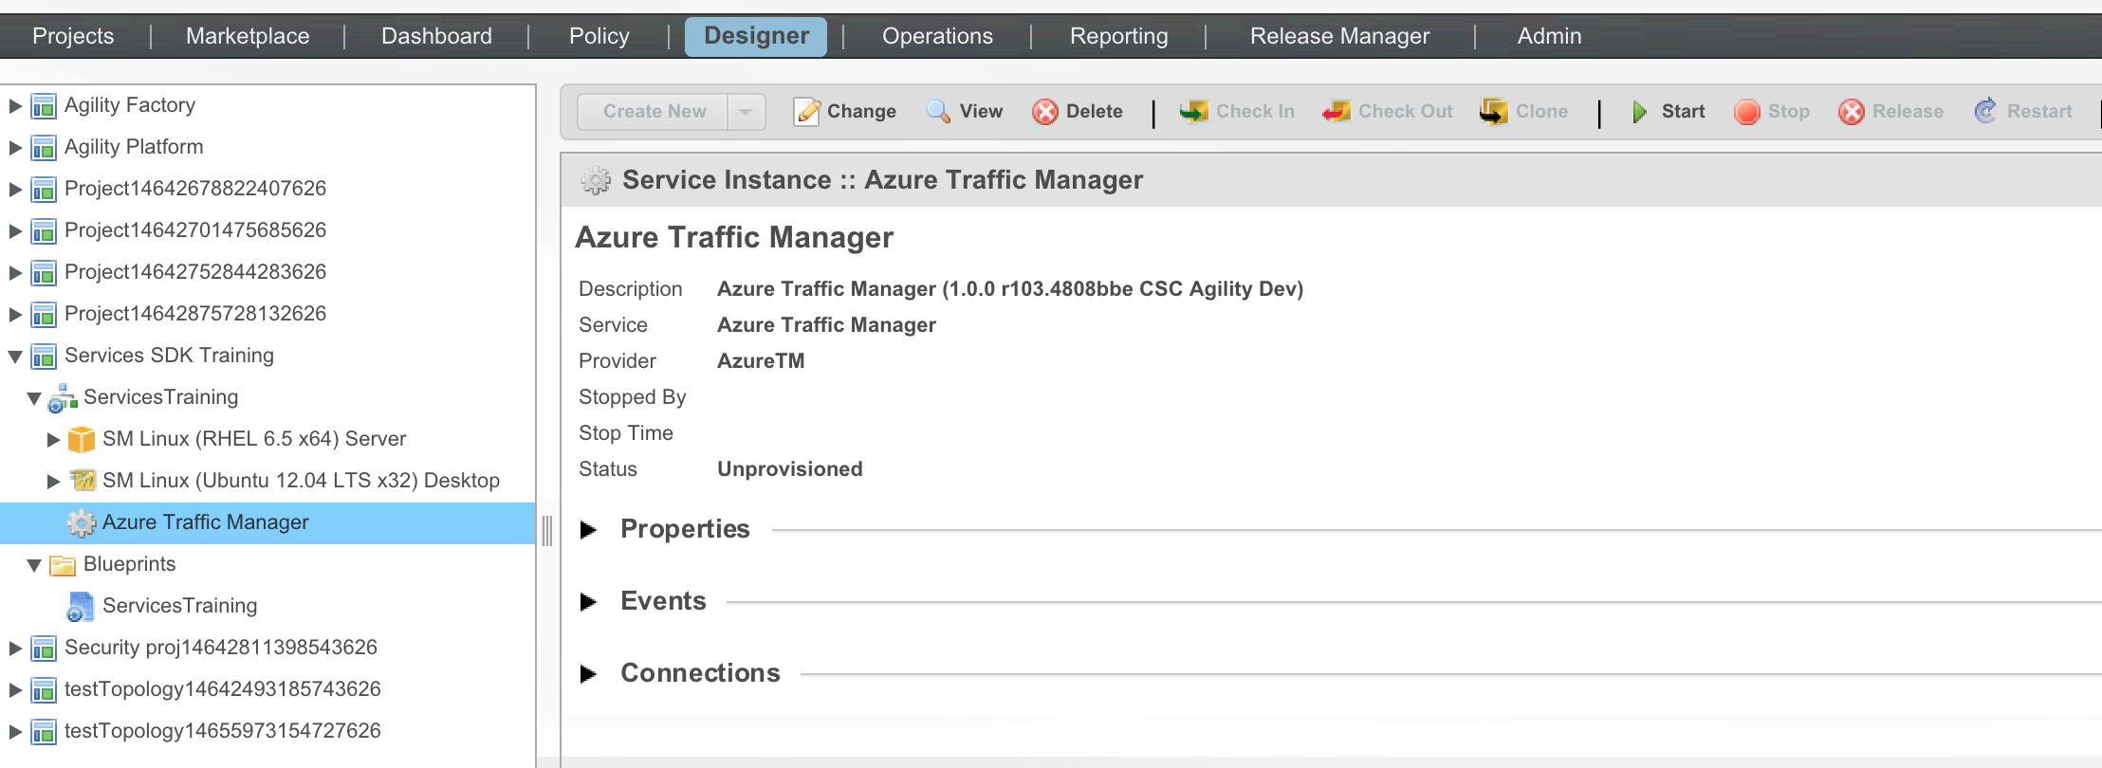
Example: Deployed Service
A Service Instance is created when the Blueprint containing a Service is deployed

Slide 13
Lab 1: Development Environment Preparation
Verify development environment has Java JDK 1.7 and ant (1.9.3)
Obtain the skeleton service adapter per instructor instructions
Attempt to build the skeleton service adapter
Import the services.training project to Eclipse (optional)
Create an Eclipse Classpath variable that points to the agility-platform-services-sdk lib folder. Step by step instructions are at the top of TrainingServiceAdapter.java
In the build.xml file, change the project name to something unique (e.g. with your name)
In the MANIFEST.MF file under META-INF, change the Bundle-Name and Bundle-SymbolicName (set SymbolicName to build.xml project name)
Run “ant clean bundle” from the services.training directory
Login to the Agility Platform per instructor instructions (or use your own Agility Platform instance)
Create a Project in the Designer perspective named after yourself

Slide 14

15 Minutes of Bliss

Slide 15
Software Architecture

Slide 16
Services SDK Software Architecture
The Agility Platform utilizes OSGi as its dynamic module system
Apache Karaf
The Services SDK is an OSGi bundle:
karaf@root()> headers 185
Agility - SDK - Service Adapter (185)
-------------------------------------
Bundle-Vendor = ServiceMesh
Bundle-Name = Agility - SDK - Service Adapter
Bundle-SymbolicName = com.servicemesh.agility.sdk.service
Bundle-Version = 1.0
Bundle-ManifestVersion = 2
Bundle-ClassPath = .,
DynamicImport-Package = *
Import-Package =
com.servicemesh.agility.api;version=3.1.0,
com.servicemesh.core.async;version=1.0.0,
com.servicemesh.core.messaging;version=1.0.0,
com.servicemesh.core.reactor;version=1.0.0,
com.servicemesh.io.proxy,
org.osgi.framework,
org.osgi.util.tracker;version=1.5.1
Export-Package = ...

Slide 17
Services SDK Dependencies
The packages imported by the Services SDK are supplied by other OSGi bundles
com.servicemesh.agility.api: Agility Platform taxonomy assets
com.servicemesh.core: Base asynchronous reactor and messaging framework
com.servicemesh.io: - Asynchronous I/O libraries for SSH/WinRM, HTTP, and HTTPS that include full proxy chain support (https/socks5)
An Agility Platform provides javadoc for the Services SDK and related packages at https://<agility_ip>/doc/dev
Also includes Agility Platform REST API Programmer’s and Reference Guides
Javadoc also in the agility-platform-services-sdk repo: doc/index.html

Slide 18
Services SDK Exported Packages
The Services SDK bundle exposes packages to a service adapter:
Export-Package =
com.servicemesh.agility.sdk.service.exception;version=1.0.0,
com.servicemesh.agility.sdk.service.helper;version=1.0.0,
com.servicemesh.agility.sdk.service.msgs;version=1.0.0,
com.servicemesh.agility.sdk.service.spi;version=1.0.0,
com.servicemesh.agility.sdk.service.operations;version=1.0.0,
com.servicemesh.agility.sdk.service.util;version=1.0.0
com.servicemesh.agility.sdk.service.exceptions: Base class for exceptions thrown by the adapter
com.servicemesh.agility.sdk.service.helper: Helper and convenience methods for manipulating API objects
com.servicemesh.agility.sdk.service.msgs: Request and response message classes passed between a service adapter and the core Agility Platform
com.servicemesh.agility.sdk.service.spi: 1) The interfaces that are implemented by a service adapter to expose supported functionality; 2) An abstract base class for a service adapter that transparently hooks the adapter into the core Agility Platform service framework
com.servicemesh.agility.sdk.service.operations: Default implementations of adapter operations that can be sub-classed by a service adapter to override specific methods
com.servicemesh.agility.sdk.service.util: Utility classes

Slide 19
Services Adapter Dependencies
A service adapter is an OSGi bundle that imports the packages exported by the Services SDK plus the packages that the SDK imports (api, core, io)
A service adapter may need to synchronize actions when the Agility Platform is utilized in its distributed configuration
com.servicemesh.agility.distributed.sync: Provides distributed mutex for synchronizing service adapter operations
A service adapter targeted to Amazon Web Services or Azure may optionally utilize a bundle with communications/utility functions
Provided by the core Agility Platform organization
com.servicemesh.agility.adapters.core.aws
In the agility-platform-services-sdk repo: services/amazonws/doc/index.html
com.servicemesh.agility.adapters.core.azure
In the agility-platform-services-sdk repo: services/azure/doc/index.html

Slide 20
Example: Azure Traffic Manager Dependencies
karaf@root()> headers 223
Agility - Azure Traffic Manger Service Provider (223)
-----------------------------------------------------
...
Import-Package =
org.apache.log4j,
com.servicemesh.agility.adapters.core.azure;version=1.0.0,
com.servicemesh.agility.adapters.core.azure.exception;version=1.0.0,
com.servicemesh.agility.adapters.core.azure.util;version=1.0.0,
com.servicemesh.agility.api,
com.servicemesh.agility.distributed.sync,
com.servicemesh.agility.sdk.service.msgs;version=1.0.0,
com.servicemesh.agility.sdk.service.spi;version=1.0.0,
com.servicemesh.agility.sdk.service.operations;version=1.0.0,
com.servicemesh.agility.sdk.service.util;version=1.0.0,
com.servicemesh.agility.sdk.service.exception;version=1.0.0,
com.servicemesh.core.async;version=1.0.0,
com.servicemesh.core.reactor,
com.servicemesh.core.messaging;version=1.0.0,
com.servicemesh.io.http,
com.servicemesh.io.proxy,
javax.xml,
javax.xml.bind,
javax.xml.datatype,
javax.crypto,
javax.crypto.spec,
org.osgi.framework;version=1.7.0

Slide 21
Asset Types

Slide 22
Agility Platform Asset Types
Assets are reusable components created and managed in the Agility Platform
Some assets, such as scripts and stacks, are granular entities used to define the basic building blocks for generating virtual machines
Other assets, such as blueprints or organizational containers, are collective entities used to manage groups of assets and define a functional unit
The Agility Platform has a meta-model of Asset Types
Each Asset Type has a name, a display name, and zero or more Properties
A Property has a name, a display name, a type (e.g., String or Integer), and optional default values and constraints
When it registers with the Agility Platform, a service adapter creates Asset Types

Slide 23
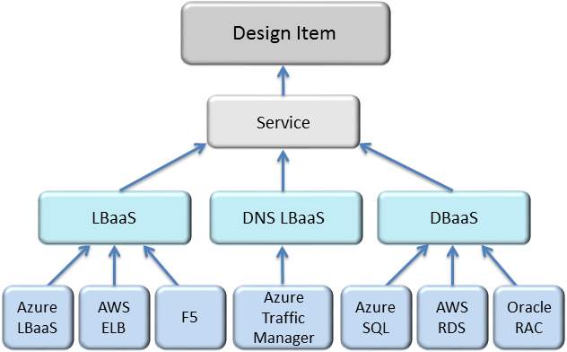
Service Asset Type Hierarchy
Service is the base type for a service asset type created by a service adapter
The Agility Platform’s meta-model includes some functional service types such as Data Base as a Service (DBaaS) or Load Balancer as a Service (LBaaS)

Slide 24
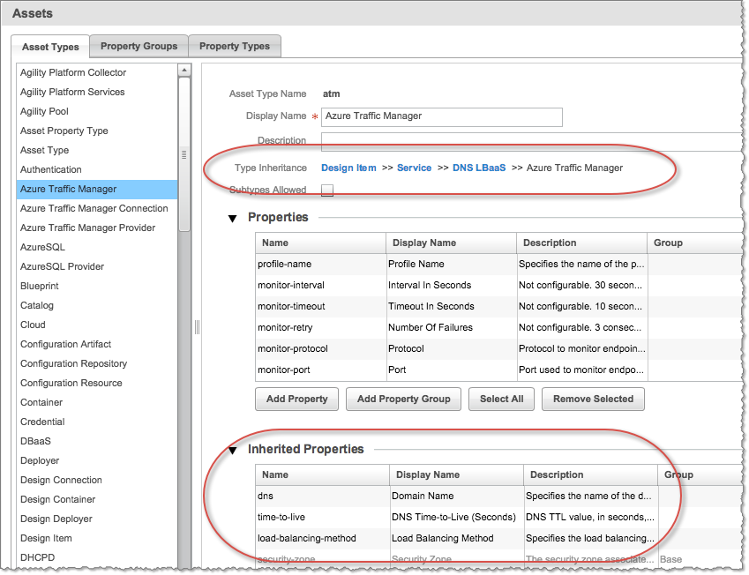
Asset Type Property Inheritance
When an asset type inherits from another type:
The base type is the supertype for the inheriting asset type
The inheriting asset type is the subtype for the supertype
The subtype inherits properties from its supertype

Slide 25
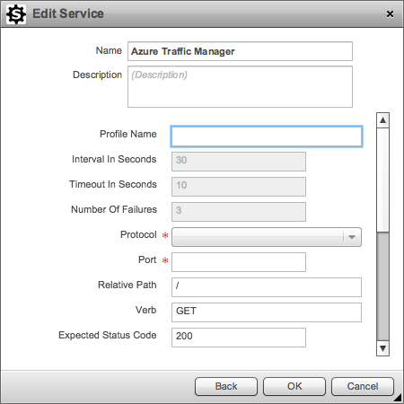
Property Setting
When a blueprint designer adds the service to a blueprint, they must set the values for properties according to the requirements set by the service adapter
Properties that are configured to use static values are in read-only mode
Required properties are indicated by a red asterisk

Slide 26
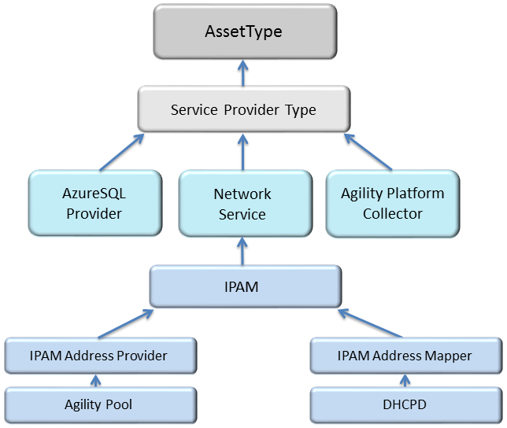
Service Provider Asset Type Hierarchy
Service Provider Type is the base type for a service provider asset type created by a service adapter
Unlike service asset types, there are no functional service provider types to be utilized by a typical service adapter
Network Service and Agility Platform Collector are special types not in scope for this discussion

Slide 27
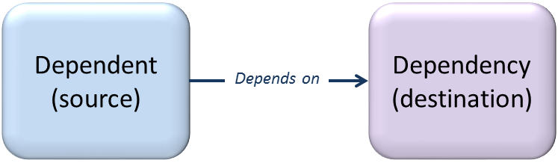
Design Connection Asset Type
Design Connection is the base type for the connection between design items in a blueprint, such as workload-workload, workload-service, or service-service
It defines no additional properties of its own
In the Blueprint Editor, dependency relationships are determined by the directionality of a connection arrow
The dependency is the tip or destination of the connection arrow and the dependent node is the base or source of the arrow.

Slide 28
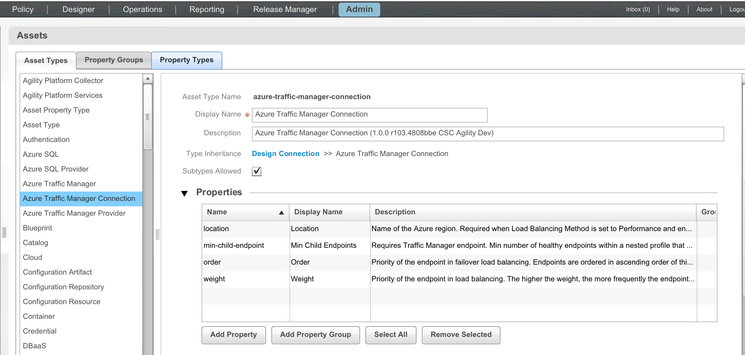
Custom Service Design Connections (1/2)
A service adapter may optionally extend design connection if it wants to have special properties on the connections between blueprint design items

Slide 29
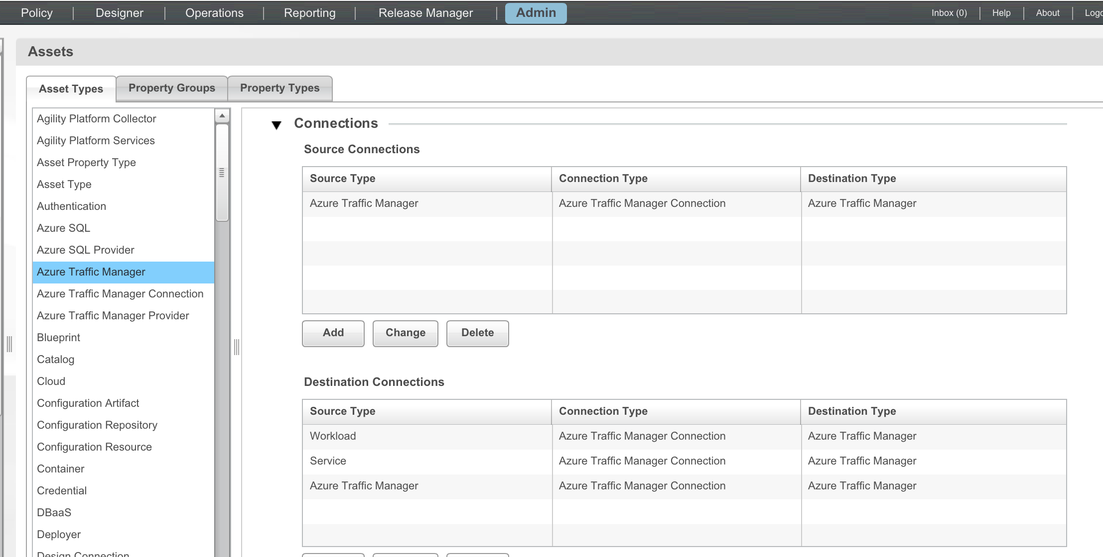
Custom Service Design Connections (2/2)
A service adapter defining its own design connection also specifies the acceptable combinations of source and destination end points

Slide 30
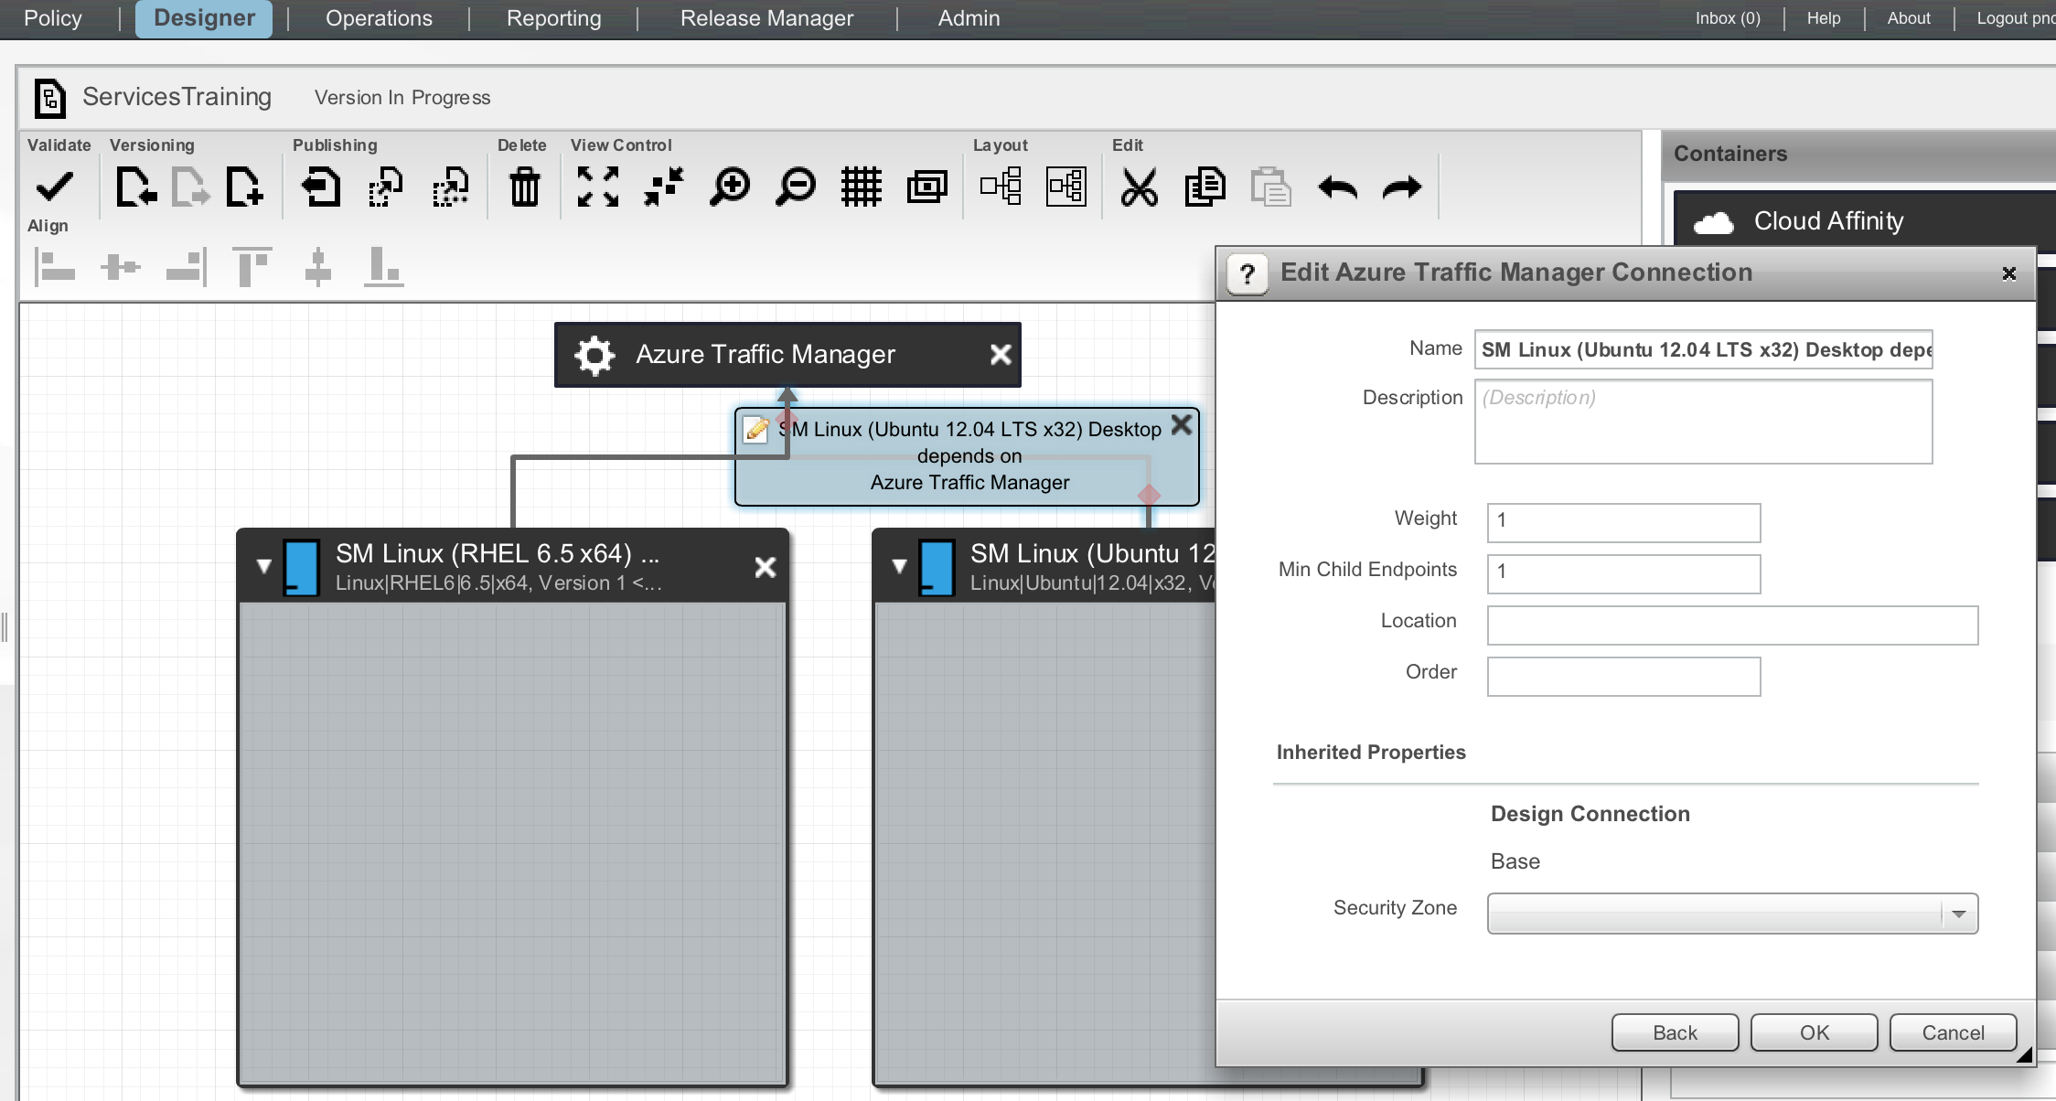
Blueprint Editor Handling of a Service Design Connection
When the cursor is placed on a connection, a blue box appears with information on the source and destination end points
Clicking on the blue box brings up an edit dialog where property values can be entered

Slide 31
Viewing Asset Type Definitions Outside the UI
REST Operations:
GET assettype/ returns all asset types
GET assettype/{id} returns the asset type with the specified identifier
GET assettype/sub/{id} returns the subtypes of the asset type with the specified identifier

Slide 32

Lunch

Slide 33
Lab 2: Example Service Adapter in Agility Platform UI
Login to the Agility Platform
Go to the Admin perspective and examine Asset Types:
Azure Traffic Manager
Azure Traffic Manager Connection
Azure Traffic Manager Provider
Go to Cloud Providers -> Azure
Under the QA SM Azure cloud click on Network Services -> Add
Select type Azure Traffic Manager Provider and enter a Name of your choosing. The credential fields can be blank (they will be inherited from the associated cloud)
Click the Test Connection button
Click the OK button to save the provider
Go to the Designer perspective and select the project created in lab 1
Select Create New and Create New Blueprint
Create a blueprint that has a SM Windows (WIN 2012 R2 x64) Server Workload, an Azure Traffic Manager service, and a connection between them
Click on the gear wheel for the service and then Asset Properties. For required properties, Protocol=HTTP, Port=80, Domain Name=<your-name>.trafficmanager.net, Load Balancing Method=Failover
Examine the Asset Properties on the connection between the workload and service and set weight=3
Save the blueprint and then deploy it in the same project
Examine the Connections section for the template and service instance in the deployed topology

Slide 34
Service Registration and Installation

Slide 35
Service Adapter Registration
The ServiceAdapter base class registers the adapter as an OSGi service and uses the OSGi service registry to look up an AsyncService implementation provided by the corresponding version of the Services SDK
The adapter must include an implementation of the ServiceAdapter.getRegistrationRequest() method

Slide 36
To Construct and Register a Service Adapter
Define the service provider type asset type(s)
Define the service asset type(s)
Define the allowed connections/dependencies
(Optional) Define custom actions

Slide 37
Asset Naming Conventions
Service Name: Include the version number in the service name in order to differentiate between service adapters.
Service Type: The name (not the display name), which is used in the blueprint editor. Agility Platform users can search for these items, so this should be spelled out (such as "my-cool-service").
Property Names: The name of a service property, which is used to define the service. Hyphen-separated ( such as "some-cool-property") is preferred over camel case.
Asset Type Descriptions: It is a best practice to include the bundle vendor and version .
For additional naming conventions see p.46 of the Services SDK Guide
CSC Devs: see p.47-48 of the Services SDK Guide for Copyright and License best practices

Slide 38
The ServiceAdapter Base Class
The ServiceAdapter abstract base class contains abstract methods for the core messaging framework and OSGi service registration.
The ServiceAdapter class implements the OSGi BundleActivator interface, which handles the adapter registration with the core platform and the registration of the message handlers for supported message types.
Service Adapters should extend the ServiceAdapter class and implement the abstract methods.

Slide 39
The RegistrationRequest Class
The com.servicemesh.agility.sdk.service.msgs.RegistrationRequest class is the container for a service adapter to specify its core data
Every service adapter must override ServiceAdapter.getRegistrationRequest() and return a populated RegistrationRequest object.

Slide 40
RegistrationRequest Attributes
Attribute | Description | Required
Name | Adapter name | Yes
Version | Adapter version | Yes
ServiceProviderTypes | the service provider type(s) exposed by the adapter | No
assetTypes | Asset type definitions for service type(s) | No
properties | List of Property objects that describe the adapter | Yes
settings | List of Settings objects that describe the adapter | Yes
supportedInterfaces | List of Agility interfaces for which the adapter is to be notified when a CRUD operation occurs | Yes
assetLifecycles | List of Agility asset classes for which the adapter is to be notified when a CRUD operation occurs | Yes

Slide 41
The ServiceProviderType Asset Type
The ServiceProviderType specifies the communications mechanism for a service adapter to manage a service in a cloud.
A ServiceProviderType defined by a service adapter becomes available as a Network Service when the adapter is installed.
A ServiceProviderType object should also be added to the RegistrationRequest serviceProviderTypes attribute

Slide 42
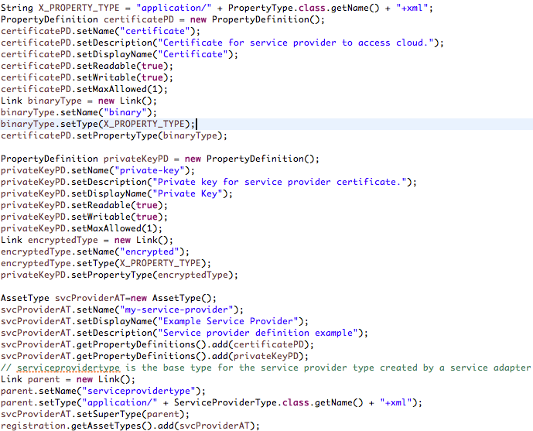
ServiceProvider Asset Type Example With 2 Properties

Slide 43
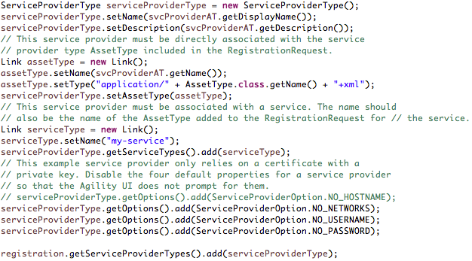
ServiceProviderType Example

Slide 44
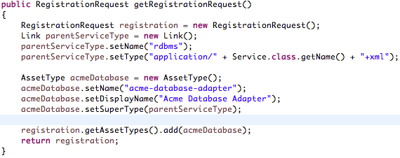
Extending an Asset Type
Example of a Service that extends one of the base Service Asset Types

Slide 45
Registration of the Service Asset Type
The Service Asset Type represents the cloud service supported by a service adapter.
The RegistrationRequest assetTypes attribute should be populated with an Asset Type that includes the properties of a service
This asset type extends from the base Service asset type or one of its child types
A Service defined by a service adapter becomes available in the Agility Platform blueprint editor upon activation of the adapter

Slide 46
Name Alignment in a ServiceAdapter Class
A Service Provider and Service created by a service adapter have:
a "database name" which is primarily used as a lookup key
a "UI name" which is primarily used in the Agility Platform user interface
E.g.:
 | Database Name | UI Name
Service Provider | azure-traffic-manager-provider | Azure Traffic Manager Provider
Service | azure-traffic-manager | Azure Traffic Manager
Important that these names are used consistently in a ServiceAdapter class
Service Provider Database Name | Service Provider UI Name | Service Database Name | Service UI Name
Link setName() AssetType setName() | Timer Reactor getTimerReactor() RegistrationRequest setName() ServiceProviderType setName() AssetType setDisplayName() | Link setName() AssetType setName() | AssetType setDisplayName()

Slide 47
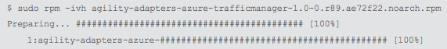
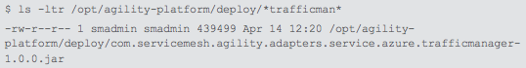
Service Adapter Installation
The initial adapter installation is very straightforward procedure—simply copy the built RPM to the Agility Platform and run the following RHEL RPM command
The installed package includes the versioning information from the build, similar to the following
This places the adapter jar in the Agility Platform deploy directory

Slide 48
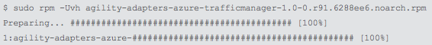
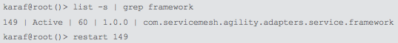
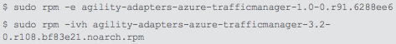
Service Adapter Updates
Use the following RHEL RPM command to update a service adapter when there are non-major/minor version affecting changes, such as bug fixes
This replaces the older jar and Agility Platform immediately starts running with the updated code
If there are issues after re-installing an adapter, you should restart the service framework bundle using the following Karaf commands
If the service adapter update is a new major or minor version, remove the old version first then install the new one.

Slide 49
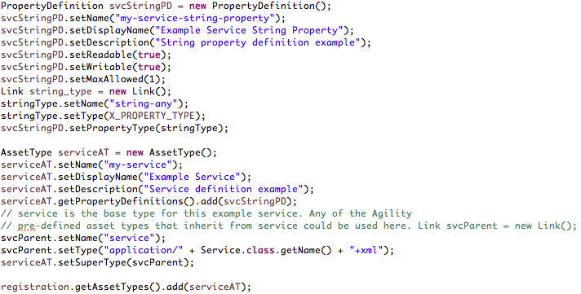
Example Service Registration for a Service With 1 Property

Slide 50
Registration Response
Service adapter is informed after the Agility Platform's service framework has processed the RegistrationRequest
@Override
public void onRegistration(RegistrationResponse response) { ...
RegistrationResponse includes:
Persisted AssetTypes
getId() is a database key
Persisted ServiceProviderTypes
Any ServiceProviders for the ServiceProviderTypes that existed before the registration
If there are ServiceProviders, the Clouds associated with those providers
onRegistration() is a logical place for a service adapter to perform advanced options
Lookup/Create/Update other Agility Platform assets, such as Policies, Packages, Scripts
See base ServiceAdapter class: createAsset(), deleteAsset(), getAsset(), getAssets(), and updateAsset()

Slide 51
Lab 3: Service Adapter Registration
This Lab will involve the TrainingServiceAdapter.java file
Extend ServiceAdapter
Implement Constructor, getRegistrationRequest, getServiceProviderTypes
Create a ServiceProvider type with no properties
Create a Service type with no properties
Use unique database and UI names (include your initials or name) and pay careful attention to name alignment
Use SCP to deploy your adapter on the Agility Platform
Verify that the ServiceProvider and Service asset types appear in the Assets tab of the Admin perspective

Slide 52
15 Minutes of Bliss

Slide 53
Supporting Connections for a Service
By default, the Agility Platform installs with two basic design connections defined:
Workload -> Workload: a workload can depend on another workload
Workload -> Blueprint: a workload can depend on an embedded blueprint
A service adapter should define the valid connections between it and workloads, blueprints and other services
To support a connection to or from the service, you create a ConnectionDefiniton
A ConnectionDefinition requires values for name, displayName, sourceType, destinationType, and connectionType
For all connections, the Source asset depends on the Destination asset

Slide 54
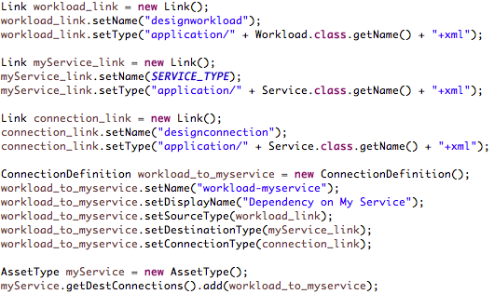
Example Connection Allowing Workloads to Depend on a Service

Slide 55
Using a Custom Design Connection Type
The main reason for using a custom connection type is to support properties associated with the connection
ll custom connection types must have DesignConnection as the top-level parent
Its possible to have a custom connection type inherit from another custom connection type. i.e. DesignConnection -> CustomA -> CustomB
Use the getRegistrationRequest method to define the custom connection type and add it to the AssetTypes list of the RegistrationRequest

Slide 56
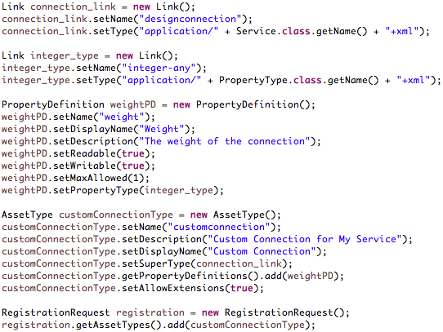
Example Custom Design Connection With 1 Property

Slide 57
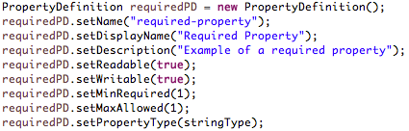
AssetType Properties – Required Properties
A service provider might require a property value such that it cannot provision a functional service without it being defined. In this case, the set the minimum number of defined values (MinRequired) to a value greater than its default of zero, such as the following example

Slide 58
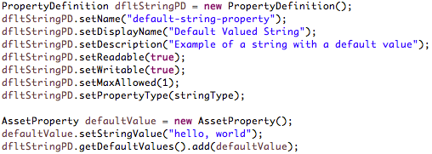
AssetType Properties – Default Values
A default value is useful where there is a typical standard or format that the consumer of the service will most likely use. Use the getDefaultValues() method to specify one or more default values for a property, such as the following example:

Slide 59
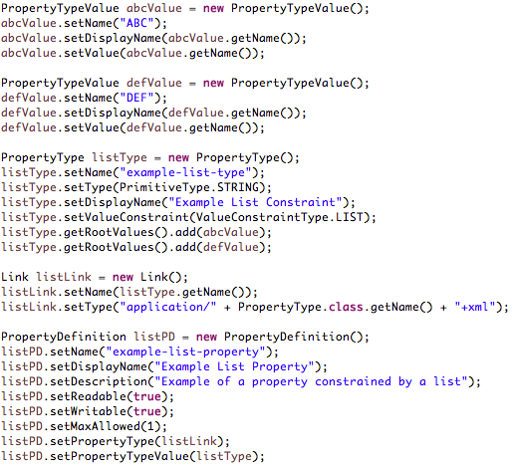
AssetType Properties – Value Lists
It is possible to create a pre defined list of values for the user to choose from. You can create a property type to specify the list of valid values, such as the example on the left

Slide 60
AssetType Properties – Property Validators
Properties for a ServiceProviderType or Service asset type can be validated through the com.servicemesh.agility.api validators
Types of Validators
Class | Purpose
DateValidator | Constrains a date value by one or more of "Past", "Future", and "Current”
EmailValidator | Constrains a string value to a valid email address
IntegerRangeValidator | Constrains an integer value by one or more min-max ranges
IntegerScaleValidator | Constrains an integer value to a maximum number of digits
NumericRangeValidator | Constrains a floating point value by one or more min-max ranges
NumericScaleValidator | Constrains a floating point value to a maximum number of digits
RegexValidator | Constrains a string to match a regular expression pattern
StringLengthValidator | Constrains a string to a maximum number of characters

Slide 61
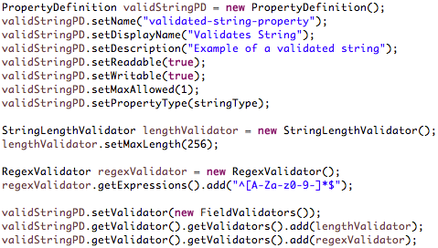
AssetType Properties – String Validators Example

Slide 62
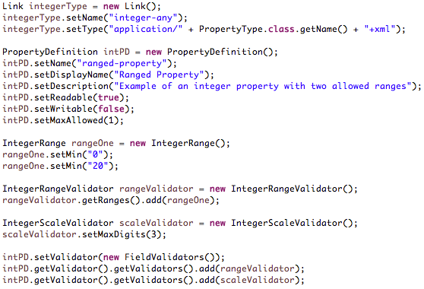
AssetType Properties – Integer Validators Example

Slide 63
Lab 4: Service Adapter Registration with Properties
This Lab will involve the TrainingServiceAdapter.java file
Extend getRegistrationRequest
Add a String property to the ServiceProvider asset type
Add an Integer property to the Service asset type
Use SCP to deploy your adapter on the Agility Platform
Examine the Assets tab of the Admin perspective (may need to refresh URL to see the latest data)

Slide 64
15 Minutes of Bliss

Slide 65
Asynchronous Promise Framework

Slide 66
Reactor Design Pattern (1/2)
The Agility Platform SDKs implement the Reactor design pattern (http://en.wikipedia.org/wiki/Reactor_pattern)
Base class com.servicemesh.agility.sdk.service.spi.ServiceAdapter
Uses interface com.servicemesh.core.reactor.Reactor
Uses class com.servicemesh.core.async.AsyncService
Request
Agility Platform Activity
Services Framework
Service Adapter Reactor Thread
Request
Each service adapter has its own thread for handling requests associated to it by the Agility Platform's Services Framework

Slide 67
Reactor Design Pattern (2/2)
Service Adapter formulates a response after interacting with cloud
Cloud actions typically conducted asynchronously
No shared state between Agility Platform core operations and an adapter
Message based to improve modularity
Reduces dependencies on Agility Platform core bundles
Base class com.servicemesh.core.messaging.Request
com.servicemesh.agility.sdk.service.msgs.RegistrationRequest
com.servicemesh.agility.sdk.service.msgs.ServiceProviderRequest
Base class com.servicemesh.core.messaging.Response
com.servicemesh.agility.sdk.service.msgs.RegistrationResponse
com.servicemesh.agility.sdk.service.msgs.ServiceProviderResponse

Slide 68
Promise Class
The lifecycle handling methods in com.servicemesh.agility.sdk.service.operations utilize the core Promise class
com.servicemesh.core.async.Promise:
Provides a functional approach for conducting asynchronous operations
The basis for this functional programming paradigm is the Function interface:
package com.servicemesh.core.async;
public interface Function<A,R> {
public R invoke(A arg);
}
Example – Traffic Manager Test Connection from Lab 2:
new Function<Profiles, ServiceProviderResponse>() {
public ServiceProviderResponse invoke(Profiles arg)
{
ServiceProviderResponse response = new ServiceProviderResponse();
response.setStatus(Status.COMPLETE);
return response;
}
}

Slide 69
Promise Status and Control Methods
Determine the status of a Promise:
Method | Description
boolean isCancelled() | Returns true if the request was canceled
boolean isCompleted() | Returns true if the request was completed
boolean isFailed() | Returns true if the request was canceled with a failure
Promise control methods:
Method | Description
void cancel() | Signals that the promise is canceled and notifies any pending threads or pending results
void onCancel(final Callback<Void> cb) | Registers a callback to be invoked on cancellation of the promise
void onComplete(final Callback<Void> cb) | Registers a callback to be invoked on completion of the promise
void onFailure(final Callback<Void> cb) | Registers a callback to be invoked if a failure condition occurs
Promise<T> recover(final Function<Throwable, T func) | Wraps a promise with another promise to handle exceptions

Slide 70
Promise Callback
The Callback interface is utilized for asynchronous control:
package com.servicemesh.core.async;
public interface Callback<T> {
public void invoke(T arg);
}
Example – release a distributed mutex:
import com.servicemesh.agility.distributed.sync.AsyncLock;
Promise<AsyncLock> lock = AsyncLock.lock("/agility/myadapter/profile/" +
profileName + "/lock");
return lock.flatMap(
new Function<AsyncLock, Promise<ServiceProviderResponse>>() {
@Override
public Promise<ServiceProviderResponse> invoke(final AsyncLock arg){
Promise<IHttpResponse> promise = ...
promise.onFailure(new Callback<Throwable>() {
public void invoke(Throwable t) {
arg.unlock();
}});
promise.onComplete(new Callback<ServiceProviderResponse>() {
public void invoke(ServiceProviderResponse t) {
arg.unlock();
}});
promise.onCancel(new Callback<Void>() {
public void invoke(Void t) {
arg.unlock();
}});
}
});

Slide 71
Promise Recovery
Example – convert an exception condition into a default value of the expected type:
Promise<Integer> promise2 = promise.recover(
new Function<Throwable, Integer>() {
@Override
public Integer invoke(final Throwable th) {
if (th instanceof ArithmeticException) {
return 0;
}
throw new IllegalArgumentException();
}
});

Slide 72
Promise Compositional Methods
Method | Description
static <T> Promise<T> pure(final T result) | Returns a completed promise with the specified result
static <T> Promise<T> pure(Throwable th) | Returns a completed promise with the specified error result
<R> Promise<R> map(final Function<T, R> func) | Returns a new promise that, on completion of the current promise, completes by mapping the result using the supplied function
<R> Promise<R> flatMap(final Function<T, Promise<R>> func) | Returns a new promise that, on completion of the current promise, completes by mapping the result using the supplied function
static <T> Promise<List<T>> sequence(final List<Promise<T>> promises) | Returns a promise that completes when the supplied list of promises complete
static Promise<List<Object>> sequenceAny(List<Promise<?>> promises) | Returns a promise that completes when the supplied list of promises complete

Slide 73
Promise Pure Methods
Return a direct conclusion - the simplest type of result:
try {
ServiceProviderResponse response = new ServiceProviderResponse();
response.setStatus(Status.COMPLETE);
// This Promise's isCompleted() will return true
return Promise.pure(response);
}
catch (Exception e) {
String err = "Exception for " + method.getName() + "'" + uri +
"': " + e.toString();
// This Promise's isFailed() will return true
return Promise.pure(new Exception(err));
}

Slide 74
Promise Map Method
Typically used to translate between an external cloud vendor data type and an internal Agility data type
Promise<Integer> mapped = promise.map(
new Function<CloudType, Integer>() {
@Override
public Integer invoke(final CloudType result)
{
// If no exception is thrown, the returned Promise's
// isCompleted() will return true.
return new Integer(result.asInteger());
}
});

Slide 75
Promise FlatMap Method
Can translate from a set of intermediate results to a promise with the final aggregated result
final Promise<Integer> flattened = promise.flatMap(
new Function<List<CloudType>, Promise<Integer>>() {
@Override
public Promise<Integer> invoke(final List<CloudType> intermed)
{
int sum = 0;
for (CloudType result : intermed) {
sum += result.asInteger();
}
return Promise.pure(new Integer(sum));
}
});

Slide 76
Promise Sequence Method
Together with a mapping method can combine the results of multiple Promises after they have completed
Promise<Integer> mappedGrandTotal(List< Promise<Integer> > promises)
{
Promise< List<Integer> > promise = Promise.sequence(promises);
return promise.map(new Function<List<Integer>, Integer>() {
@Override
public Integer invoke(final List<Integer> subs)
{
int grand = 0;
for (Integer sub : subs) {
grand += sub.intValue();
}
return new Integer(grand);
}
});
}

Slide 77
Promise SequenceAny Method
Similar to sequence() but can work with Promises associated with generic types
Promise<Integer> flattenedGrandTotal(List< Promise<Object> > promises) {
Promise< List<Object> > promise = Promise.sequenceAny(promises);
return promise.flatMap(new Function< List<Object> , Promise<Integer> >() {
@Override
public Promise<Integer> invoke(final List<Object> subs)
{
int grand = 0;
for (Object sub : subs) {
if (sub instanceof Integer)
grand += ((Integer)sub).intValue();
else if (sub instanceof String) {
try {
grand += Integer.parseInt((String)sub);
}
catch (NumberFormatException nfe) {
String err = "Invalid sub: " + (String)sub;
return Promise.pure(new Exception(err));
}
}
}
return Promise.pure(new Integer(grand));
}
});
}

Slide 78
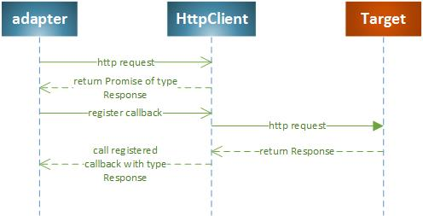
HttpClient with Promises
The com.servicemesh.io bundle provides HTTP client actions via promises
A service adapter can make an HTTP request and synchronously or asynchronously process the HTTP response
Asynchronous:

Slide 79
HttpClient Asynchronous Promise Example
Data encode/decode for an adapter is application specific
E.g., core.aws and core.azure bundles utilize JAXB marshalling/unmarshalling
public Promise<T> put(String uri, Object resource, final Class<T> responseClass) {
try {
com.servicemesh.io.http.IHttpRequest request =
com.servicemesh.io.http.HttpClientFactory.getInstance()
.createRequest(HttpMethod.PUT, uri);
String content = _endpoint.encode(resource);
addContentTypeHeader(request);
request.setContent(content);
Promise<IHttpResponse> promise = _httpClient.promise(request);
if (responseClass.getCanonicalName()
.equals(IHttpResponse.class.getCanonicalName()))
return (Promise<T>)promise;
else
return promise.map(new Function<IHttpResponse, T>() {
@Override
public T invoke(IHttpResponse response) {
return _endpoint.decode(response, responseClass);
}
});
}
catch (Exception e) {
String err = "Exception for put " + uri + ": " + e.toString();
return Promise.pure(new Exception(err));
}
}

Slide 80
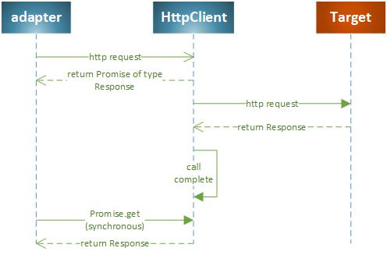
HttpClient Synchronous Promise Example
Synchronous handling not typically used
Uses blocking Promise get() method
String uri = new String("http://www.csc.com");
IHttpRequest request =
HttpClientFactory.getInstance().createRequest(HttpMethod.GET, uri);
Promise<IHttpResponse> promise = httpClient.promise(request);
IHttpResponse response = promise.get()

Slide 81
Lab 5: Promise Exercises
Complete the methods in training/promise.exercises/src/promise/exercises/PromiseExercises.java and execute the program to verify your work
Be brave and avoid PromiseExercisesAnswersNoPeeking.java ☺

Slide 82
Service Provider Operations

Slide 83
IServiceProvider
The com.servicemesh.agility.sdk.service.spi.IServiceProvider interface returned by getServiceProviderOperations() includes a standard set of operations for managing the service provider, as well as lifecycle callouts for changes to the service provider configuration/definition
All the methods in the interface return Promise<ServiceProviderResponse>
Method | Description
preCreate(ServiceProviderPreCreateRequest request) | Used by the service provider to validate the configuration of the adapter and allow/reject the settings
postCreate(ServiceProviderPostCreateRequest request) | Called after successful configuration of the service provider A service adapter could require some sync of the initial configuration with the actual service provider
preUpdate(ServiceProviderPreUpdateRequest request) | Used by the service adapter to validate the configuration of the service provider and allow/reject the settings

Slide 84
IServiceProvider Continued
Method | Description
postUpdate(ServiceProviderPostUpdateRequest request) | Called after successful configuration of the service provider. A service adapter could require some sync of the new configuration with the actual service provider
preDelete(ServiceProviderPreDeleteRequest request) | Used by the service provider to validate the system is in a valid state to perform a delete
postDelete(ServiceProviderPostDeleteRequest request) | Used to clean up any resources associated with the service provider instance
ping (ServiceProviderPingRequest request) | Called by Agility Platform to request a sync of the current service configuration with the provider
sync(ServiceProviderSyncRequest request) | Called by Agility Platform to request a sync of the current service configuration with the provider
start(ServiceProviderStartRequest request) | Called from Agility Platform to request a start of the service provider
stop(ServiceProviderStopRequest request) | Called from Agility Platform to request a stop of the service provider

Slide 85
ServiceProviderRequest Class
The Services SDK ServiceProviderRequest class is the basis for the parameters to the IServiceProvider methods
The ServiceProviderRequest methods provide information to the service adapter
Method | Description
getProvider() | Returns the service provider
getSettings() | Returns zero or more configuration Property objects as specified by the service adapter RegistrationRequest
getClouds() | Returns the cloud(s) associated with the service provider
getProxies() | Returns zero or more proxies used to configure communications with the service provider
getLocations() | Returns zero or more locations associated with the service provider
getNetworks() | Returns zero or more networks associated with the service provider
getServiceProviderTypes() | Returns a list of all service provider types used by assets associated with a provided service
getServiceProviders() | Returns a list of all service providers used by assets associated with a provided service

Slide 86
ServiceProviderResponse
The Services SDK ServiceProviderResponse class is returned by an IServiceProvider method
The ServiceProviderResponse object allows a service adapter to provide information back to the Agility Platform Services framework.
Method | Description
getModified() | Returns the Agility Platform asset(s) with attributes modified by the service adapter The service framework subsequently persists the assets.

Slide 87
ServiceProviderSyncRequest
Of all the ServiceProvider****Request classes, Only ServiceProviderSyncRequest provides extra methods with additional information. Those methods are listed below.
Method | Description
getServiceInstances() | Returns a list of all service instances associated with the service provider
getConnectedAssets() | Returns a list of all assets connected to the service instances
getConnections() | Returns a list of all connections to the service instances

Slide 88
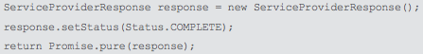
ServiceProviderOperations
The Services SDK provides com.servicemesh.agility.sdk.service.operations.ServiceProviderOperations, a default implementation of IServiceProvider for which every method simply returns a completed promise
A service adapter should extend ServiceProviderOperations and override methods as needed
For example, implementations of preCreate() and preUpdate() could verify that the required access credentials are available for a service provider while an adapter ping() could attempt an actual connection using those credentials

Slide 89
Lab 6: ServiceProvider Operations
Using the same project from previous labs:
Derive from the SDK's ServiceProviderOperations class
Implement the ping operation and have it dump the value of the String property you set up in Lab 3 to the logs.
Implement the ServiceAdapter method to return an instance of your operations class
IServiceProvider getServiceProviderOperations()
Build your project and deploy the new version to the Agility Platform and try out your service
The ping operation is triggered by the Test Connection button under CloudProvider -> NetworkServices

Slide 90
Service Instance Operations

Slide 91
IServiceInstance
The Agility Platform creates a ServiceInstance asset upon successful deployment of a Blueprint containing a Service
The com.servicemesh.agility.sdk.service.spi.IServiceInstance interface returned by a service adapter getServiceInstanceOperations() represents the operations for a ServiceInstance
Similar to the IServiceProvider, these methods return Promise<ServiceProviderResponse>

Slide 92
IServiceInstance Methods
Method | Description
validate(ServiceInstanceValidateRequest request) | Validates the configuration of the service instance prior to deployment, update, or delete and prevents the event for an invalid configuration
provision(ServiceInstanceProvisionRequest request) | Provisions resources in the cloud upon service instance creation
reconfigure (ServiceInstanceReconfigureRequest request) | Revises any affected resources in the cloud after update of a service instance
start(ServiceInstanceStartRequest request) | Starts a service from a stopped/suspended state
stop(ServiceInstanceStopRequest request) | Puts a running service into a stopped/suspended state
release(ServiceInstanceReleaseRequest request) | Releases any resources in the cloud associated with the service instance

Slide 93
What Calls the IServiceInstance Methods?
IServiceInstance method invocations can occur during the following service-related Business Process Model and Notation (BPMN) workflows
Workflow | Workflow Node | IServiceInstance Methods
service-provision | SetStateStarting | validate(ServiceInstanceValidateRequest) reconfigure(ServiceInstanceReconfigureRequest) provision(ServiceInstanceProvisionRequest)
service-stop | SetStateStopping | validate(ServiceInstanceValidateRequest) reconfigure(ServiceInstanceReconfigureRequest) stop(ServiceInstanceStopRequest)
service-start | SetStateStarting | validate(ServiceInstanceValidateRequest) reconfigure(ServiceInstanceReconfigureRequest) start(ServiceInstanceStartRequest)
service-restart | SetStateStopping | validate(ServiceInstanceValidateRequest) reconfigure(ServiceInstanceReconfigureRequest) stop(ServiceInstanceStopRequest) start(ServiceInstanceStartRequest)
service-release | SetStateStopping | validate(ServiceInstanceValidateRequest) reconfigure(ServiceInstanceReconfigureRequest) release(ServiceInstanceReleaseRequest)
service-delete | PreDelete Callout | validate(ServiceInstanceValidateRequest)

Slide 94
ServiceInstanceRequest Class
The Services SDK ServiceInstanceRequest class is the basis for the parameters to the IServiceInstanceLifecycle methods
ServiceInstanceRequest extends ServiceProviderRequest with the following methods:
Method | Description
getServiceInstance() | Returns the service instance
getOriginalServiceInstance() | During an update, returns the service instance as currently persisted
getDependentServiceInstance() | During validation of an update to the service instance, returns a service instance asset that is connected to this service instance
getSrcConnections() | Returns a List of all connections from this service instance to another Agility Platform asset
getDestConnections() | Returns a List of all connections to this service instance from another Agility Platform asset
getDependencies() | Returns a List of all Agility Platform assets upon which this service instance has a dependency
getDependents() | Returns a List of all Agility Platform assets that are dependent upon this service

Slide 95
ServiceInstanceValidateRequest
Of all the ServiceInstance****Request classes, Only ServiceInstanceValidateRequestprovides has an extra with additional information. The method is listed below.
Method | Description
getMode() | Returns the type of operation performed: CREATE, UPDATE, or DELETE

Slide 96
ServiceInstanceOperations
The Services SDK provides com.servicemesh.agility.sdk.service.operations.ServiceInstanceOperations as a default implementation of IServiceInstance for which every method simply returns a completed promise.
A service adapter should extend ServiceInstanceOperations and override methods as needed

Slide 97
15 Minutes of Bliss

Slide 98
Lab 7: ServiceInstance Operations
Using the same project as previous labs:
Derive from the SDK's ServiceInstanceOperations class
Implement the validate method for ValidateMode.CREATE and have it check that the Integer property you set up in Lab 3 is not negative.
Implement the start and release methods and have them write something like “<Your name’s> service says hello” or “<Your name’s> service is taking a nap”
Implement the ServiceAdapter method to return an instance of your operations class
IServiceInstance getServiceInstanceOperations()
Build your project and deploy the new version to the Agility Platform and try out your service
The validate method will execute when you try to deploy your blueprint
The start and release methods will execute when you start or release your deployed service instance

Slide 99
Lunch

Slide 100
Instance Operations

Slide 101
IInstanceLifecycle
A Blueprint can contain design connections between a Workload and a Service. When the Blueprint is deployed, Agility Platform creates an Instance asset for each Workload and a ServiceInstance asset for each Service. The design connections define the dependencies between these created assets
The Service SDK IInstanceLifecycle interface represents the operations for a service adapter to consider when an Instance bound to a ServiceInstance changes state.
All of the methods in IInstanceLifecycle return Promise<InstanceResponse>

Slide 102
IInstanceLifecycle Methods
Method | Description
preProvision(InstancePreProvisionRequest request) | Indicates beginning of the provisioning workflow for a connected Instance
postProvision(InstancePostProvisionRequest request) | Indicates completion of the provisioning workflow for a connected Instance
preBoot(InstancePreBootRequest request) | Indicates the VM for a connected Instance is preparing to boot (cloned but not powered)
postBoot(InstancePostBootRequest request) | Indicates the VM for a connected Instance has booted In this state, it should have an IP address but configuration management is not yet applied.
preStop(InstancePreStopRequest request) | Indicates the VM for a connected Instance is preparing to stop
postStop(InstancePostStopRequest request) | Indicates the VM for a connected Instance is stopped without releasing its underlying resources
preStart(InstancePreStartRequest request) | Indicates the VM for a connected Instance that is in a stopped state is preparing to start

Slide 103
IInstanceLifecycle Methods Continued
Method | Description
postStart(InstancePostStartRequest request) | Indicates the startup of the VM for a connected Instance is completed
preRestart(InstancePreRestartRequest request) | Indicates the VM for a connected Instance is preparing to restart (similar to the power-cycling of a physical hardware server)
postRestart(InstancePostRestartRequest request) | Indicates the restart of the VM for a connected Instance is completed
preRelease(InstancePreReleaseRequest request) | Indicates the VM for a connected Instance is going to be destroyed
postRelease(InstancePostReleaseRequest request) | Indicates the destruction of the VM for a connected Instance is completed
preReconfigure(InstancePreReconfigureRequestrequest) | IndicatestheTemplateforaconnectedInstanceis preparing to change a resource
postReconfigure(InstancePostReconfigureRequest request) | IndicatestheresourcechangeonaTemplatefora connected Instance is completed

Slide 104
What Calls the IInstanceLifecycle Methods?
IInstanceLifecycle method invocations can occur during the following instance-related Business Process Model and Notation (BPMN) workflows
Workflow | Workflow Node | IInstanceLifecycle Method
instance-provision | PreProvisionCallout | preProvision(InstancePreProvisionRequest)
instance-provision | Provision Instance | preBoot(InstancePreBootRequest)
instance-provision | PostProvisionBefore | postProvision(InstancePostProvisionRequest)
instance-stop | PreStopCallout | preStop(InstancePreStopRequest)
instance-stop | PostStopCallout | postStop(InstancePostStopRequest)
instance-start | PreStartCallout | preStart(InstancePreStartRequest)
instance-start | PostStartBeforeCallout | postStart(InstancePostStartRequest)
instance-release | PreReleaseCallout | preRelease(InstancePreReleaseRequest)
instance-release | Release Instance | postRelease(InstancePostReleaseRequest)
instance-release | PostReleaseCallout | postRelease(InstancePostReleaseRequest)

Slide 105
InstanceRequest Class
The Services SDK InstanceRequest class is the basis for the parameters to the IInstanceLifecycle methods.
InstanceRequest extends ServiceProviderRequest with the following methods
Method | Description
getInstance() | Returns the VM instance
getTemplate() | Returns the template for the instance
getServiceInstance() | Returns the service instance asset connected to the VM instance
getPeerServiceInstances() | Returns a List of service instances that are the destination of connections to the template associated with the instance
getSrcConnections() | Returns a List of all connections from the service instance to another Agility Platform asset
getDestConnections() | Returns a List of all connections to the service instance from another Agility Platform asset
getDependencies() | Returns a List of all Agility Platform assets upon which this service has a dependency
getDependents() | Returns a List of all Agility Platform assets dependent upon this service

Slide 106
InstanceResponse Class
The Services SDK InstanceResponse class is wrapped by the promise returned by the InstanceLifecycle methods
InstanceResponse extends ServiceProviderResponse with the following methods
Method | Description
getInstance() | Returns the modified instance The value is null if not set.
setInstance(Instance value) | Used by the service adapter to set the modified instance from the request that triggered the response. The Services framework subsequently persists the instance asset. The service adapter can skip setting the instance in the response if it does not modify the instance from the request.

Slide 107
InstanceOperations
The Services SDK provides com.servicemesh.agility.sdk.service.operations.InstanceOperations as a default implementation of IInstanceLifecycle, for which every method simply returns a completed promise
A service adapter should extend InstanceOperations and override methods as needed

Slide 108
Lab 8: Instance Operations
Create a Connection Definition in your registration requests that allows a workload to depend on your service.
Implement the InstanceOperations class
Implement the postStart method and have it log a message similar to “<Instance name> was started and connected to <your service name>”
Implement the postRelease method and have it log a message similar to “<Instance name> is gone. Time to clean up”
Build your project and deploy it to the Agility Platform to test your changes. On your Blueprint, add a workload and connect it to your service. Deploy your blueprint and start the resulting topology. When the instance starts you should see the postStart message. Then release the instance to see the postRelease message.

Slide 109
15 Minutes of Bliss

Slide 110
Service Instance Lifecycle Operations

Slide 111
IServiceInstanceLifecycle
Blueprints can contain design connections between two Services.
The Service-Service design connection also has a Source end and a Destination end, but the source ServiceInstance asset is dependent upon the destination ServiceInstance asset
The Service SDK IServiceInstanceLifecycle interface represents the operations for a service adapter to consider when a ServiceInstance bound to another ServiceInstance changes state
All of the IServiceInstanceLifecycle methods return Promise<ServiceProviderResponse>

Slide 112
IServiceInstanceLifecycle Methods
Method | Description
preProvision(ServiceInstancePreProvisionRequest request) | Indicates a connected ServiceInstance is beginning its provisioning workflow
postProvision(ServiceInstancePostProvisionRequest request) | Indicates the service provisioning in the cloud for a connected ServiceInstance is completed
preStop(ServiceInstancePreStopRequest request) | Indicates the service for a connected ServiceInstance is preparing to stop
postStop(ServiceInstancePostStopRequest request) | Indicates the service for a connected ServiceInstance is stopped without releasing its underlying resources
preStart(ServiceInstancePreStartRequest request) | Indicates the service for a connected ServiceInstance that is in a stopped state is preparing to start
postStart(ServiceInstancePostStartRequest request) | Indicates the start of a service for a connected ServiceInstance is completed

Slide 113
IServiceInstanceLifecycle Methods Continued
Method | Description
preRestart(ServiceInstancePreRestartRequest request) | Indicates the service for a connected ServiceInstance is preparing to restart
postRestart(ServiceInstancePostRestartRequest request) | Indicates the restart of the service for a connected ServiceInstance is completed
preRelease(ServiceInstancePreReleaseRequest request) | Indicates the service for a connected ServiceInstance is going to be destroyed
postRelease(ServiceInstancePostReleaseRequest request) | Indicates the destruction of the service for a connected ServiceInstance is completed

Slide 114
What Calls the IServiceInstanceLifecycle methods?
IServiceInstanceLifecycle method invocations can occur during the following service- related Business Process Model and Notation (BPMN) workflows
Workflow | Workflow Node | IServiceInstanceLifecycle Method
service-provision | PreProvisionCallout | preProvision(ServiceInstancePreProvisionRequest)
service-provision | PostProvisionCallout | postProvision(ServiceInstancePostProvisionRequest)
service-stop | PreStopCallout | preStop(ServiceInstancePreStopRequest)
service-stop | PostStopCallout | postStop(ServiceInstancePostStopRequest)
service-start | PreStartCallout | preStart(ServiceInstancePreStartRequest)
service-start | PostStartCallout | postStart(ServiceInstancePostStartRequest)
service-release | PreReleaseCallout | preRelease(ServiceInstancePreReleaseRequest)
service-release | PostReleaseCallout | postRelease(ServiceInstancePostReleaseRequest)

Slide 115
ServiceInstanceLifecycleRequest Class
The Services SDK ServiceInstanceLifecycleRequest class is the basis for the parameters to the IServiceInstanceLifecycle methods.
ServiceInstanceLifecycleRequest extends ServiceInstanceRequest with the following method
Method | Description
getPeerServiceInstances() | Returns a List of service instances that are the destination of connections to the cycling service instance

Slide 116
ServiceInstanceLifecycleOperations
The Services SDK provides com.servicemesh.agility.sdk.service.operations.ServiceInstanceLifecycleOperations as a default implementation of IServiceInstanceLifecycle, for which every method simply returns a completed promise
A service adapter should extend ServiceInstanceLifecycleOperations and override methods as needed

Slide 117
Connection Operations

Slide 118
IConnection
The Agility Platform REST API provides methods for affecting deployed connections between Runtime Assets (Templates,Services).
Invocation of a POST, PUT, or DELETE method triggers the service adapter connection operations if either end of the connection has a service provider associated with the adapter
The Service SDK IConnection interface represents the operations for a service adapter to consider when a Connection is created, updated, or deleted
All IConnection methods return Promise<ServiceProviderResponse>
Action | REST Type | URI
Delete a connection | DELETE | connection/{id}
Get all connections | GET | connection/
Search for connections | GET | connection/search
Get connection by ID | GET | connection/{id}
Create a connection | POST | connection/
Update a connection | PUT | connection/{id}

Slide 119
Iconnection Methods
Method | Description
preCreate(ConnectionPreCreateRequest request) | Used by the adapter to validate the configuration of the connection prior to creation and allow/reject the settings
postCreate(ConnectionPostCreateRequest request) | Called after successful creation of the connection
preUpdate(ConnectionPreUpdateRequest request) | Used by the adapter to validate the configuration of the connection prior to an update and allow/reject the settings
postUpdate(ConnectionPostUpdateRequest request) | Called after successful update of the connection
preDelete(ConnectionPreDeleteRequest request) | Used by the adapter to validate the system is in a valid state to perform a delete
postDelete(ConnectionPostDeleteRequest request) | Called after successful deletion of the connection

Slide 120
ConnectionRequest Class
The Services SDK ConnectionRequest class is the basis for the parameter to the IConnection methods.
ConnectionRequest extends ServiceProviderRequest with the following methods
Method | Description
getConnection() | Returns the Connection asset
getSource() | Returns the asset at the source end of the connection
getDestination() | Returns the asset at the destination end of the connection
getDestConnections() | Returns a List of all connections to the service instance
getDepenents() | Returns a List of assets dependent on this service instance

Slide 121
ConnectionOperations
The Services SDK provides com.servicemesh.agility.sdk.service.operations.ConnectionOperations as a default implementation of IConnection, for which every method simply returns a completed promise.
A service adapter should extend ConnectionOperations and override methods as needed

Slide 122
Asset Operations

Slide 123
IAssetLifecycle
The AssetOperations exist to allow service adapters to receive notifications and perform any necessary actions when a CRUD operation is executed for an associated Asset
The Service SDK IAssetLifecycle interface represents the operations for a service adapter to consider when an Asset associated with the service changes state
All of the IAssetLifecycle methods return Promise<ServiceProviderResponse>

Slide 124
IAssetLifecycle Methods
Method | Description
preCreate(PreCreateRequest request) | Used by the service adapter to validate the Asset
postCreate(PostCreateRequest request) | Called after a successful creation of the Asset
preUpdate(PreUpdateRequest request) | Used by the service adapter to validate the Asset prior to the Asset update
postUpdate(PostUpdateRequest request) | Called after a successful update of the Asset
preDelete(PreDeleteRequest request) | Used by the service adapter to validate the system is in a valid state to delete the Asset
postDelete(PostDeleteRequest request) | Called after a successful deletion of an Asset

Slide 125
AssetOperations Request Objects
All of the AssetOperations request objects extend ServiceProviderRequest with the following methods
Method | Description
getAsset() | Returns the asset that is changing state
setAsset(Asset value) | Used by the Services framework to populate the Asset in the request

Slide 126
Registration of Assets
In order for the service adapter to use AssetOperations, it must know the type of Asset(s) on which to perform lifecycle operations.
This is done by adding the Asset class name to the AssetLifecycles list in the RegistrationRequest that is returned in getRegistrationRequest

Slide 127
AssetOperations
The Services SDK provides com.servicemesh.agility.sdk.service.operations.AssetOperations as a default implementation of IAssetLifecycle, for which every method simply returns a completed promise
A service adapter should extend AssetOperations and override methods as needed

Slide 128
15 Minutes of Bliss

Slide 129
Agility Platform Policies and Services

Slide 130
Agility Platform Policies
An Agility Platform Policy
Defines extensible, declarative rules for security, configuration, and event handling
Is enforced for user specified situations and locations
The following types of Policies are applicable to Services
LifecycleValidation
LifecyclePostProcess
Deployment
Firewall
Workflow

Slide 131
LifecycleValidation Policy
Can govern a service instance prior to service instance lifecycle event(s):
Create Initial creation of a service instance
Update Modification of an existing service instance
Delete Removal of an existing service instance
Provision Creation of a runtime service instance in a cloud
Start Starting a service instance
Stop Stopping a service instance
Restart Restarting a service instance
Release Releasing a service instance
Example: Require a created service instance to have a name that starts with "ServiceInstance"
<LifecycleCallout>
<assetType>serviceinstance</assetType>
<lifecycleEvent>Create</lifecycleEvent>
<script><![CDATA[var name = agility.params.get("this").getName();
name != null && name.startsWith("ServiceInstance");]]></script>
</LifecycleCallout>

Slide 132
LifecyclePostProcess Policy
Can govern a service instance after service instance lifecycle event(s)
Same events as LifecycleValidation Policy
Example: Automatically add "ProvisionTest" to the name of a provisioned service instance
<LifecycleCallout>
<assetType>serviceinstance</assetType>
<lifecycleEvent>Provision</lifecycleEvent>
<script><![CDATA[var asset = agility.params.get("this");
api=agility.getApi();
asset.setName(asset.getName() + "ProvisionTest");
api.update(asset);]]></script>
</LifecycleCallout>

Slide 133
Deployment Policy
Can govern the resources for a service instance during the instance's deployment
Example – assign a service instance to a service provider based on the service name specified in a blueprint:
<ResourcePolicy>
<mapping>
<name>QA Lab Service Provider Assignment</name>
<condition> <match>
<type>application/com.servicemesh.agility.api.Service+xml</type>
<property name="name" value="QA Traffic Manager"/>
</match> </condition>
<inclusion> <item>
<type>application/com.servicemesh.agility.api.ServiceProvider+xml</type>
<name>QA Lab Traffic Manager Service Provider</name>
<id>353</id>
</item> </inclusion>
</mapping>
<mapping>
<name>Dev Lab Service Provider Assignment</name>
<condition> <match>
<type>application/com.servicemesh.agility.api.Service+xml</type>
<property name="name" value="Dev Traffic Manager"/>
</match> </condition>
<inclusion> <item>
<type>application/com.servicemesh.agility.api.ServiceProvider+xml</type>
<name>Dev Lab Traffic Manager Service Provider</name>
<id>523</id>
</item> </inclusion>
</mapping>
</ResourcePolicy>

Slide 134
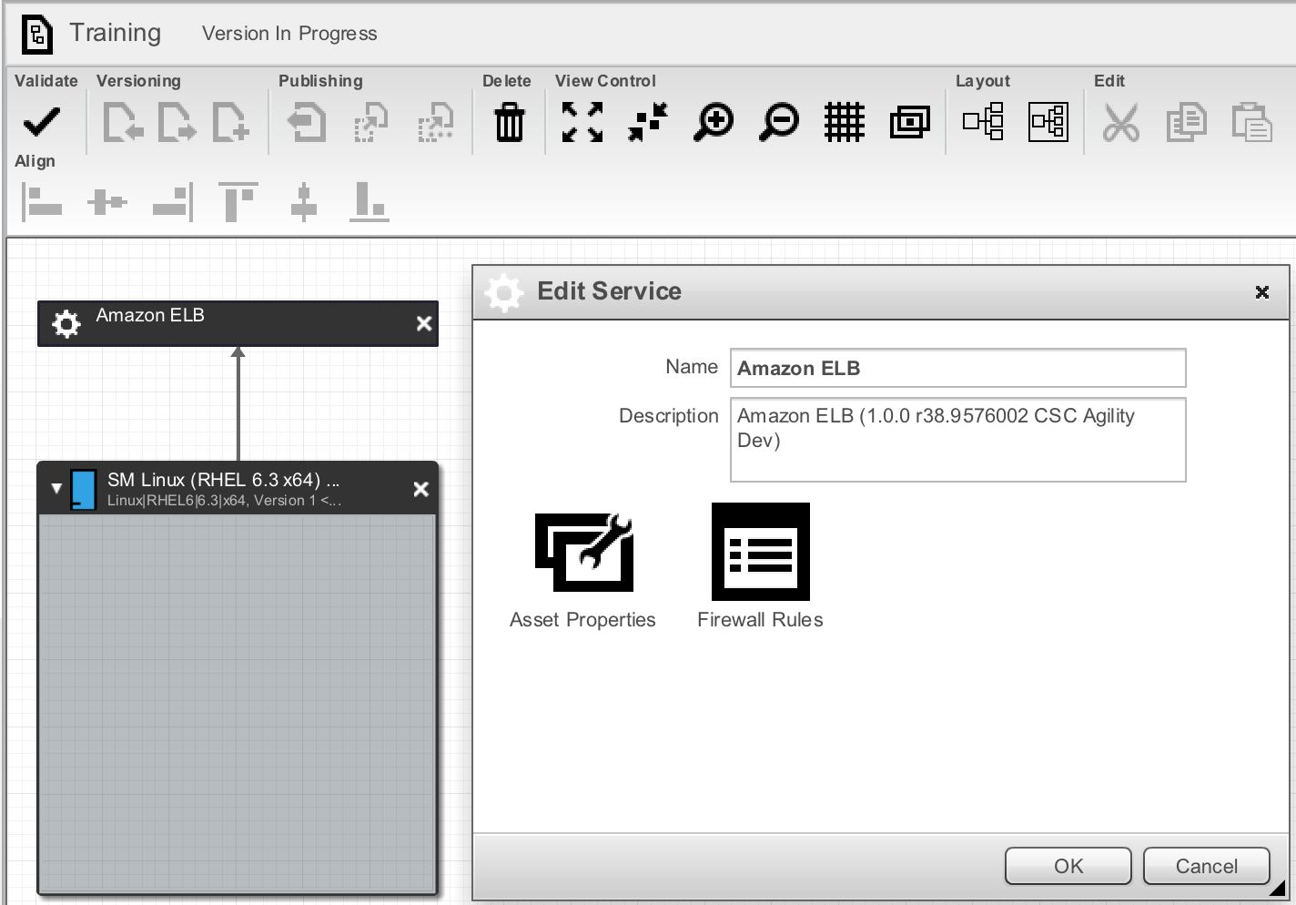
Firewall Policy (1/2)
Only applicable if a service adapter registers support:
AssetType serviceType = new AssetType();
serviceType.setName(MY_SERVICE_TYPE);
...
serviceType.getEditors().add(com.servicemesh.agility.api.Editor.FIREWALL);
registration.getAssetTypes().add(serviceType);
Once registered, the blueprint editor allows firewall rules to be specified for the service

Slide 135
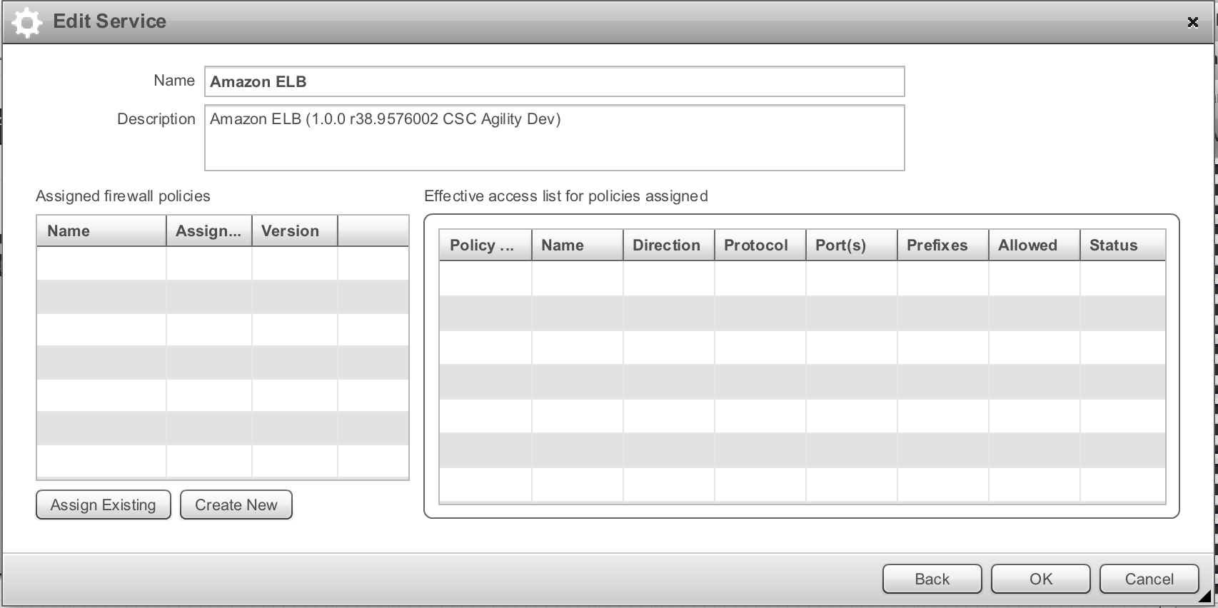
Firewall Policy (2/2)
Specified firewall rules are subsequently available for a deployed service instance:
import com.servicemesh.agility.api.AccessList;
ServiceInstanceRequest request;
ServiceInstance serviceInstance = request.getServiceInstance();
for (AccessList acl : serviceInstance.getFirewallRules()) {
// Apply firewall rule to service instance in the cloud
}

Slide 136
Worfklow Policy
Governs service instance lifecycle event processing per BPMN workflow
Service Provision Creation of a runtime service instance in a cloud
Service Start Starting a service instance
Service Stop Stopping a service instance
Service Restart Restarting a service instance
Service Release Releasing a service instance
Service Delete Removal of an existing service instance

Slide 137
Service Adapter Packaging and Distribution

Slide 138
Service Adapter Bundle Manifest (1/2)
The manifest for a service adapter include OSGi bundle attributes
Bundle-ManifestVersion Always use 2
Bundle-Name A human readable name
Bundle-SymbolicName The package containing the SDK ServiceAdapter derivation
Bundle-Version Convention is <major>.<minor>.<build>
Bundle-Activator The class derived from SDK ServiceAdapter
Bundle-Vendor The organization that developed the adapter
Core Agility Platform or Agility Platform adapters teams use CSC Agility Dev
Other CSC groups with some appropriate designation, e.g. CSC EBG Pro Services
Third parties utilize organization name and business line
Bundle-Category Use adapter:service – this is a filter for REST GET adapter/
Bundle-Description To promote support, include build information in the text
For general information on OSGi bundle manifests, see http://wiki.osgi.org/wiki/Category:Manifest_Header

Slide 139
Service Adapter Bundle Manifest (2/2)
Example
Bundle-ManifestVersion: 2
Bundle-Name: Agility - Azure Traffic Manger Service Provider
Bundle-SymbolicName: com.servicemesh.agility.adapters.service.azure.trafficmanager
Bundle-Version: 1.0.0
Bundle-Activator: com.servicemesh.agility.adapters.service.azure.trafficmanager.TrafficManagerAdapter
Bundle-Vendor: CSC Agility Dev
Bundle-Category: adapter:service
Bundle-Description: Agility adapter to the Microsoft Azure Traffic Manager service. Revision r103.4808bbe.
See services/azure/reference/com.servicemesh.agility.adapters.service.azure.trafficmanager/build.xml for setting Bundle-Version and Bundle-Description at build time
The Agility convention for versioning components includes these aspects:
Major version number
Minor version number
Build version number
A count of the number of source code commits in the last build of the software
Hash value representing the latest source code commit in the last build of the software

Slide 140
Service Adapter Jar
Agility Platform core convention is to name the jar file
<package-name>-<major>.<minor>.<build>.jar
com.servicemesh.agility.adapters.service.azure.trafficmanager-1.0.0.jar
For informal testing, drop the jar file into /opt/agility-platform/deploy
A service adapter bundle interacts with the rest of the Agility Platform through the service framework bundle
When running the Agility Platform in debug mode, look in the log for a message like:
21:56:32,437 DEBUG [develop-10x-fresh0002.qa.servicemesh.com:ServiceFramework]:
RegistrationHandler:190 - Azure Traffic Manager Provider 1.0.0:
{ServiceProviderType: [ Azure Traffic Manager Provider(16) ]} {AssetType: [
azure-traffic-manager(93); azure-traffic-manager-connection(92);
azure-traffic-manager-provider(94) ]}
If issues are seen after re-deploying an adapter with major changes, try restarting the service framework bundle:
$ ssh -p 8022 karaf@127.0.0.1
karaf@root()> list -s | grep framework
149 | Active | 60 | 1.0.0 |
com.servicemesh.agility.adapters.service.framework
karaf@root()> restart 149
The list command is also a good way to verify a service adapter has no wiring issues
Should have state Active – a state of Installed indicates wiring/dependency issues

Slide 141
Service Adapter RPM
For formal testing and deployments on Red Hat Enterprise Linux (RHEL), convention is to use a RPM that utilizes versioning aspects in its name:
agility-adapters-azure-trafficmanager-<A>.<B>-<C>.r<D>.<E>.noarch.rpm
agility-adapters-azure-trafficmanager-1.0-0.r103.4808bbe.noarch.rpm
See services/azure/reference/com.servicemesh.agility.adapters.service.azure.trafficmanager/rpm/SPECS/agility-adapters-azure-trafficmanager.spec and the trafficmanager build.xml
When using a service adapter in a distributed configuration, the service adapter RPM must get added to the Optional Cloud Adapters YUM group
See the Installing Asynchronous Adapters topic in the Agility Platform Installation and Setup Guide

Slide 142
Embedded Jars
A service adapter jar may contain external jars that it utilizes, such as a jar with a client API obtained from the service's provider
Each embedded jar must be included in the MANIFEST.MF's Bundle-Classpath
Bundle-Classpath is a comma-separated list of jar file names
Packages in embedded jars must be made visible to the service adapter's core reactor thread
Recommended approach is to set the class loader for the thread in the service adapter's constructor
super(TimerReactor.getTimerReactor(SERVICE_PROVIDER_NAME));
Thread reactorThread = getReactor().getThread();
ClassLoader loader = MyServiceAdapter.class.getClassLoader();
reactorThread.setContextClassLoader(loader);
Another approach is to list package names in the MANIFEST.MF's Export-Package
Export-Package is a comma-separated list of fully-qualified package names
Use version qualifier to lessen potential conflicts with other bundles
Export-Package: com.foo.bar;version="1.0"

